Slide 1

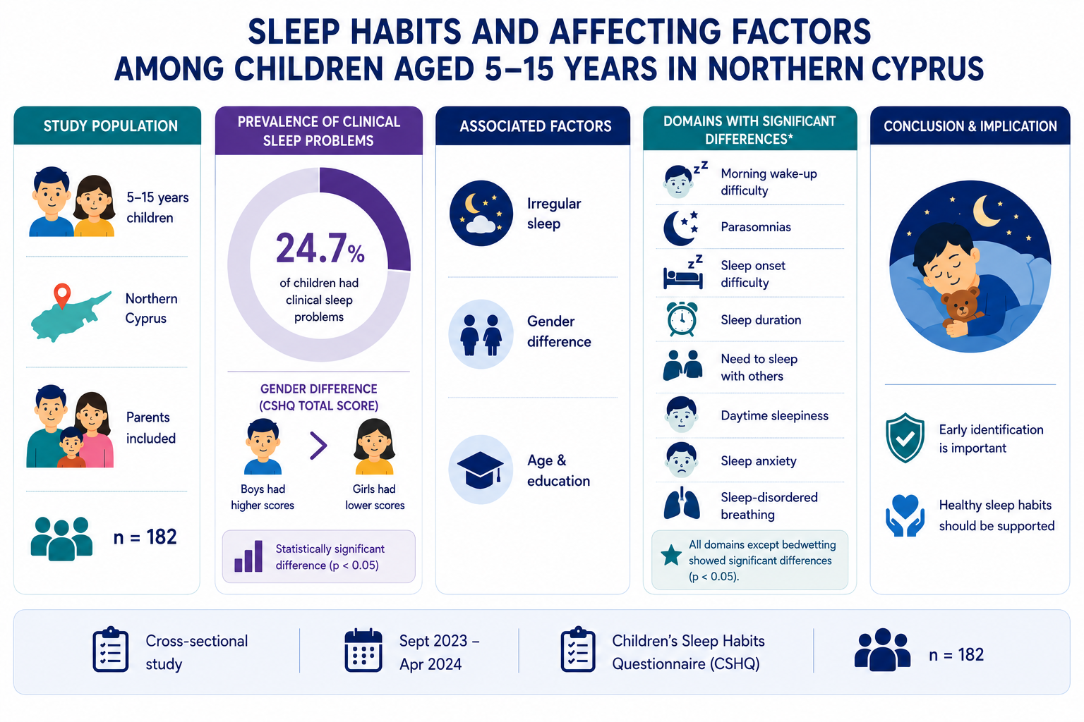
Original Article / Özgün Makale
DO­I: 10.4274/jtsm.galenos.2025.41033
Sleep Habits and Problems among Children Aged 5–15 Years in Northern Cyprus
ABSTRACT
Objective: This study aims to examine the sleep habits of children living in Northern Cyprus and to identify socio-demographic factors that influence these habits.
Materials and Methods: A cross-sectional, descriptive, and comparative study was conducted with 182 children and their parents between September 2023 and April 2024. Data were collected using the Personal Information Form and the Children’s Sleep Habits Questionnaire.
Results: Irregular sleep patterns and gender differences were associated with sleep habits. Significant differences were observed in several sleep domains.
Conclusion: Early identification and intervention for childhood sleep issues may contribute positively to children’s overall development and well-being.
Cite this article as: Agu D, Öztürk C. Sleep habits and problems among children aged 5–15 years in Northern Cyprus. J Turk Sleep Med. [Epub Ahead of Print]

